Slide 1
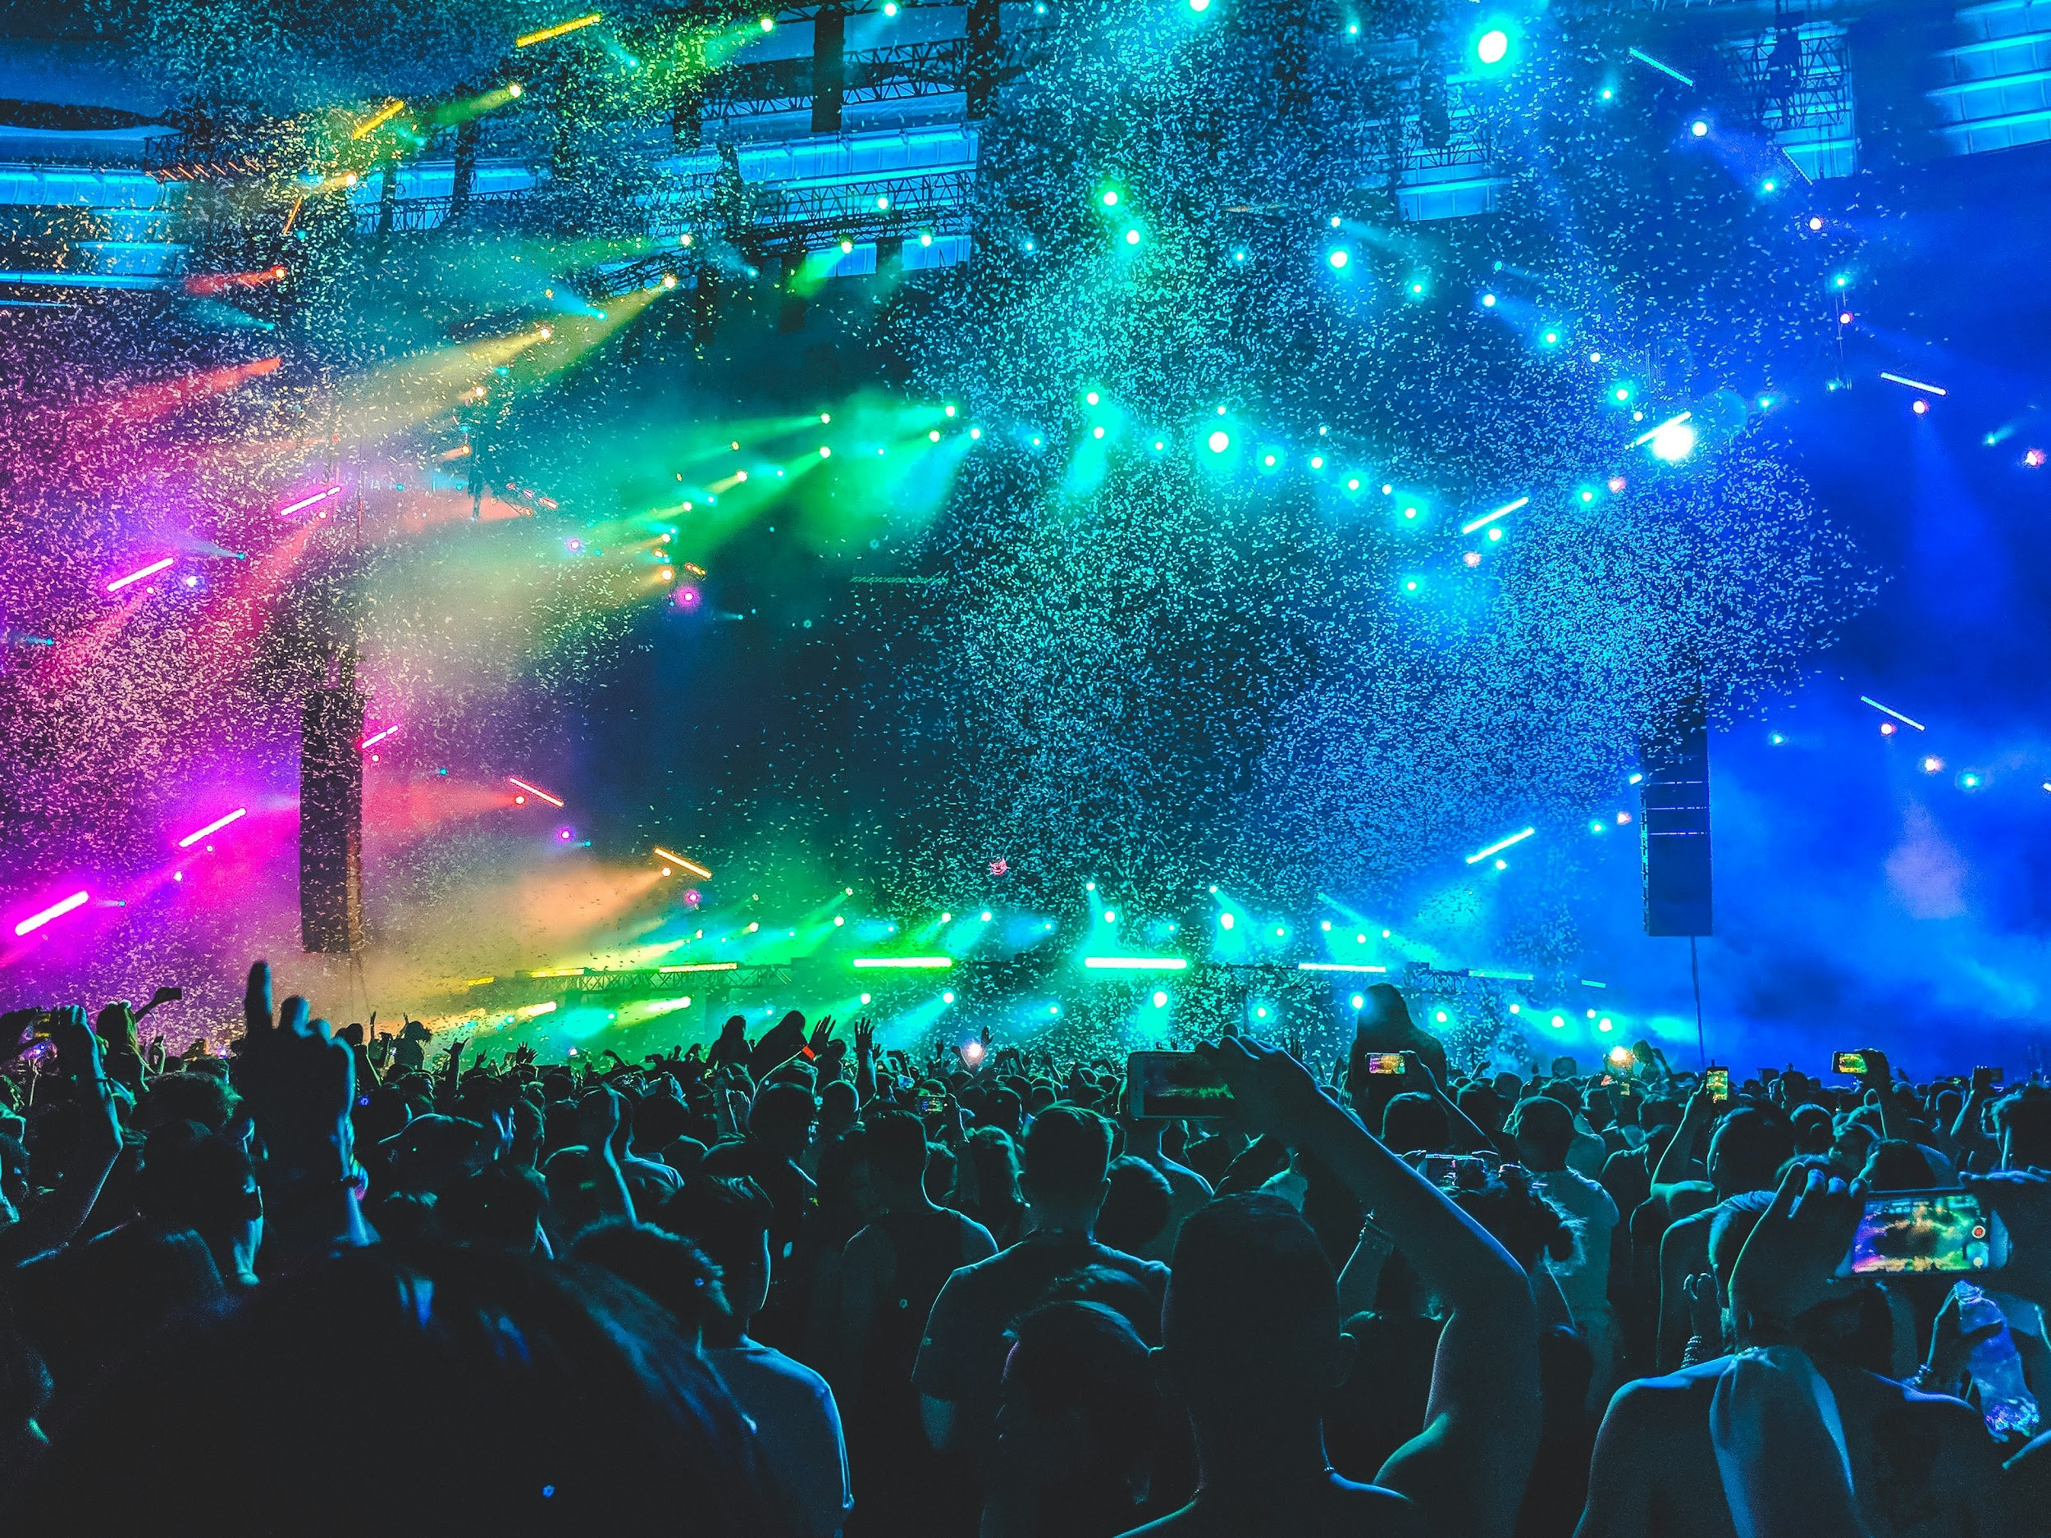



Pulse
Event Discovery, Powered by Community
Event Discovery, Powered by Community
Luis Cortes

Slide 2
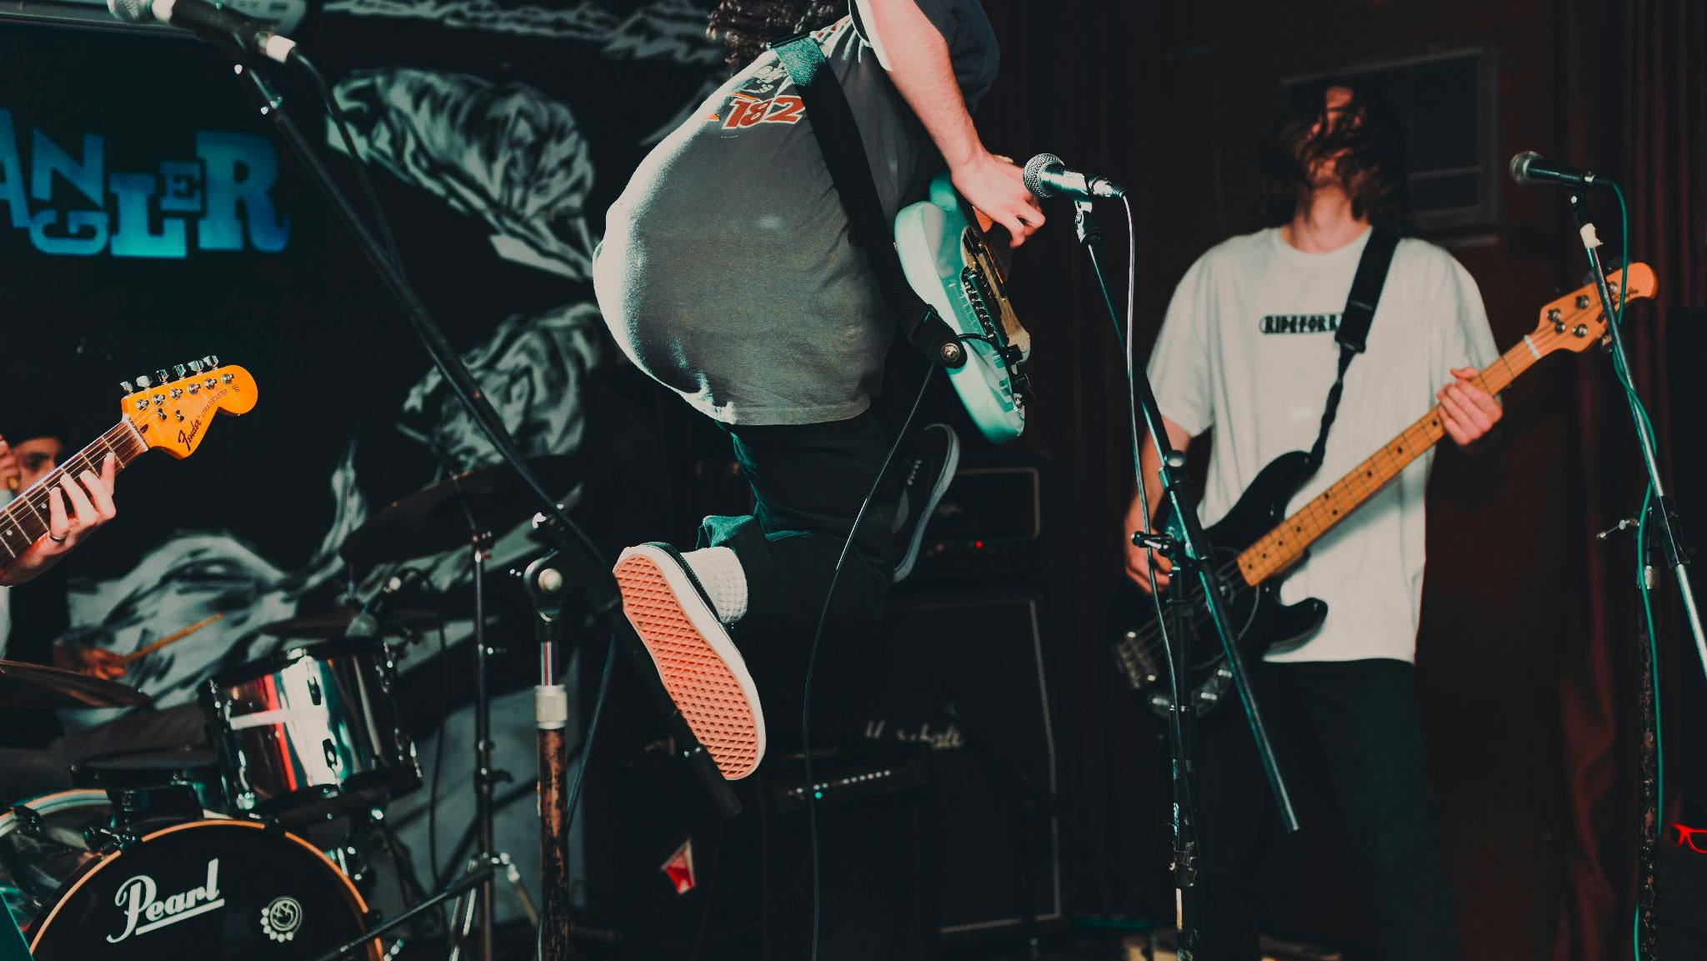
Mission statement:
Bring power to the people by streamlining community discovery.
What’s more punk rock than community?

Slide 3

The Death of Community
What is happening in your community right now?
How do you seek out what is happening around you?
Community is hard to find.

Slide 4
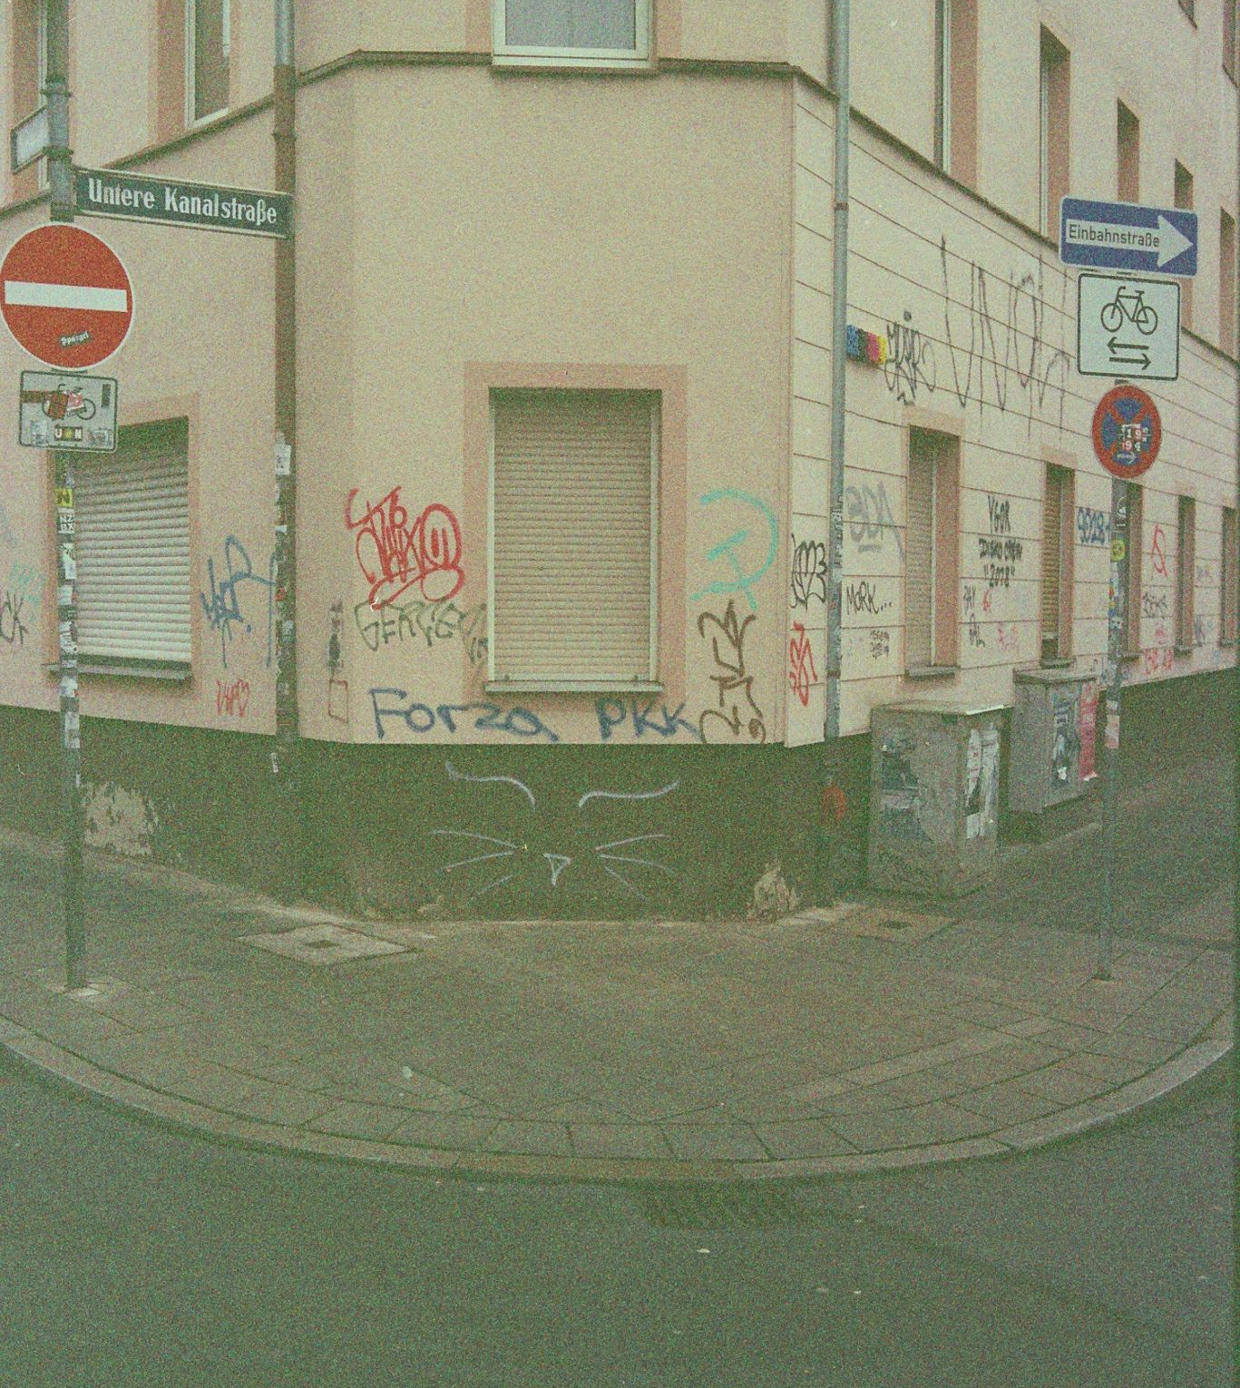

By the Community,
for the Community
We save ourselves, Community driven event discovery.

Slide 5


Money Talks
The internet runs on advertisements, we will be no different.
In 2023, Google's ad revenue amounted to 264.59 billion U.S. dollars. ₁
With community driven engagement, costs will be minimal.
https://www.statista.com/statistics/266249/advertising-revenue-of-google/

Slide 6



Competition
Community focus
Simplicity is king
Ease of use

Slide 7
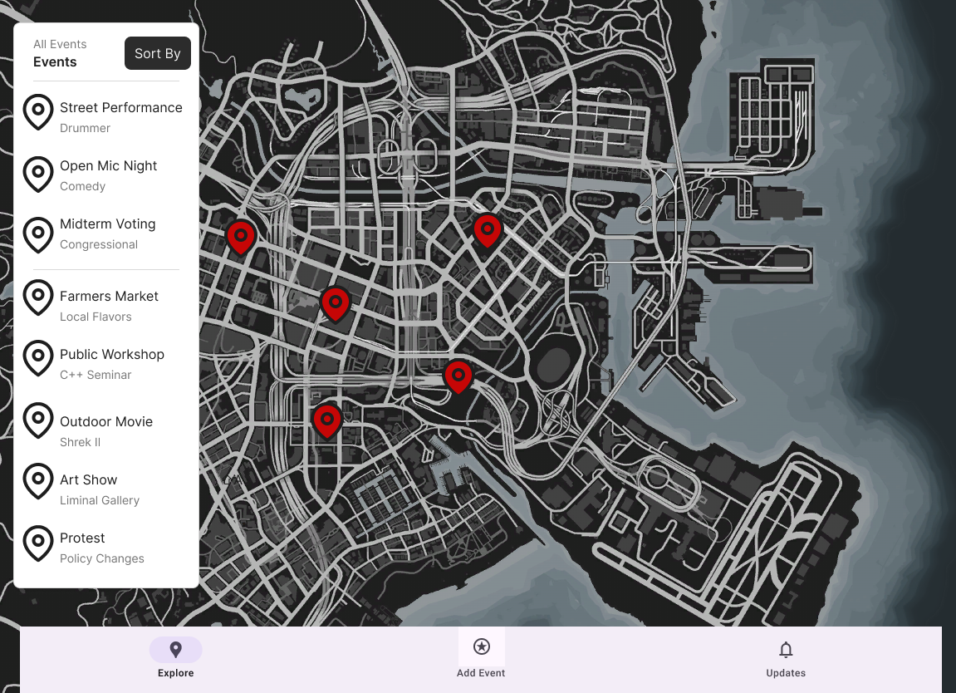

Initial Mockup

Slide 8
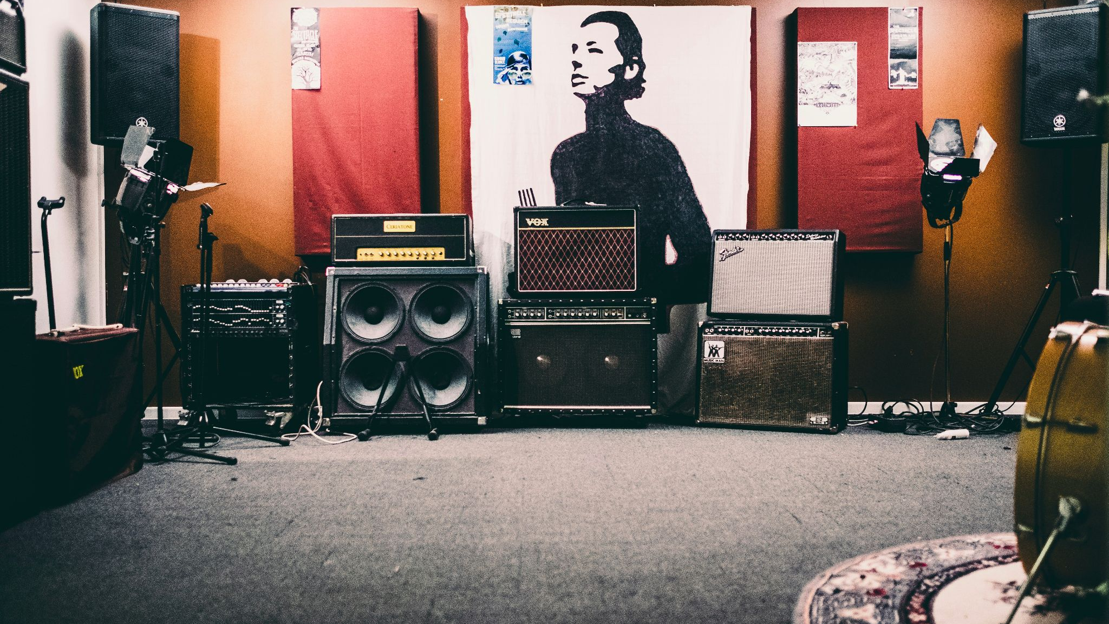
Technology:
Flask | Google API | Vite + React | Postgres | Tailwind

Slide 9

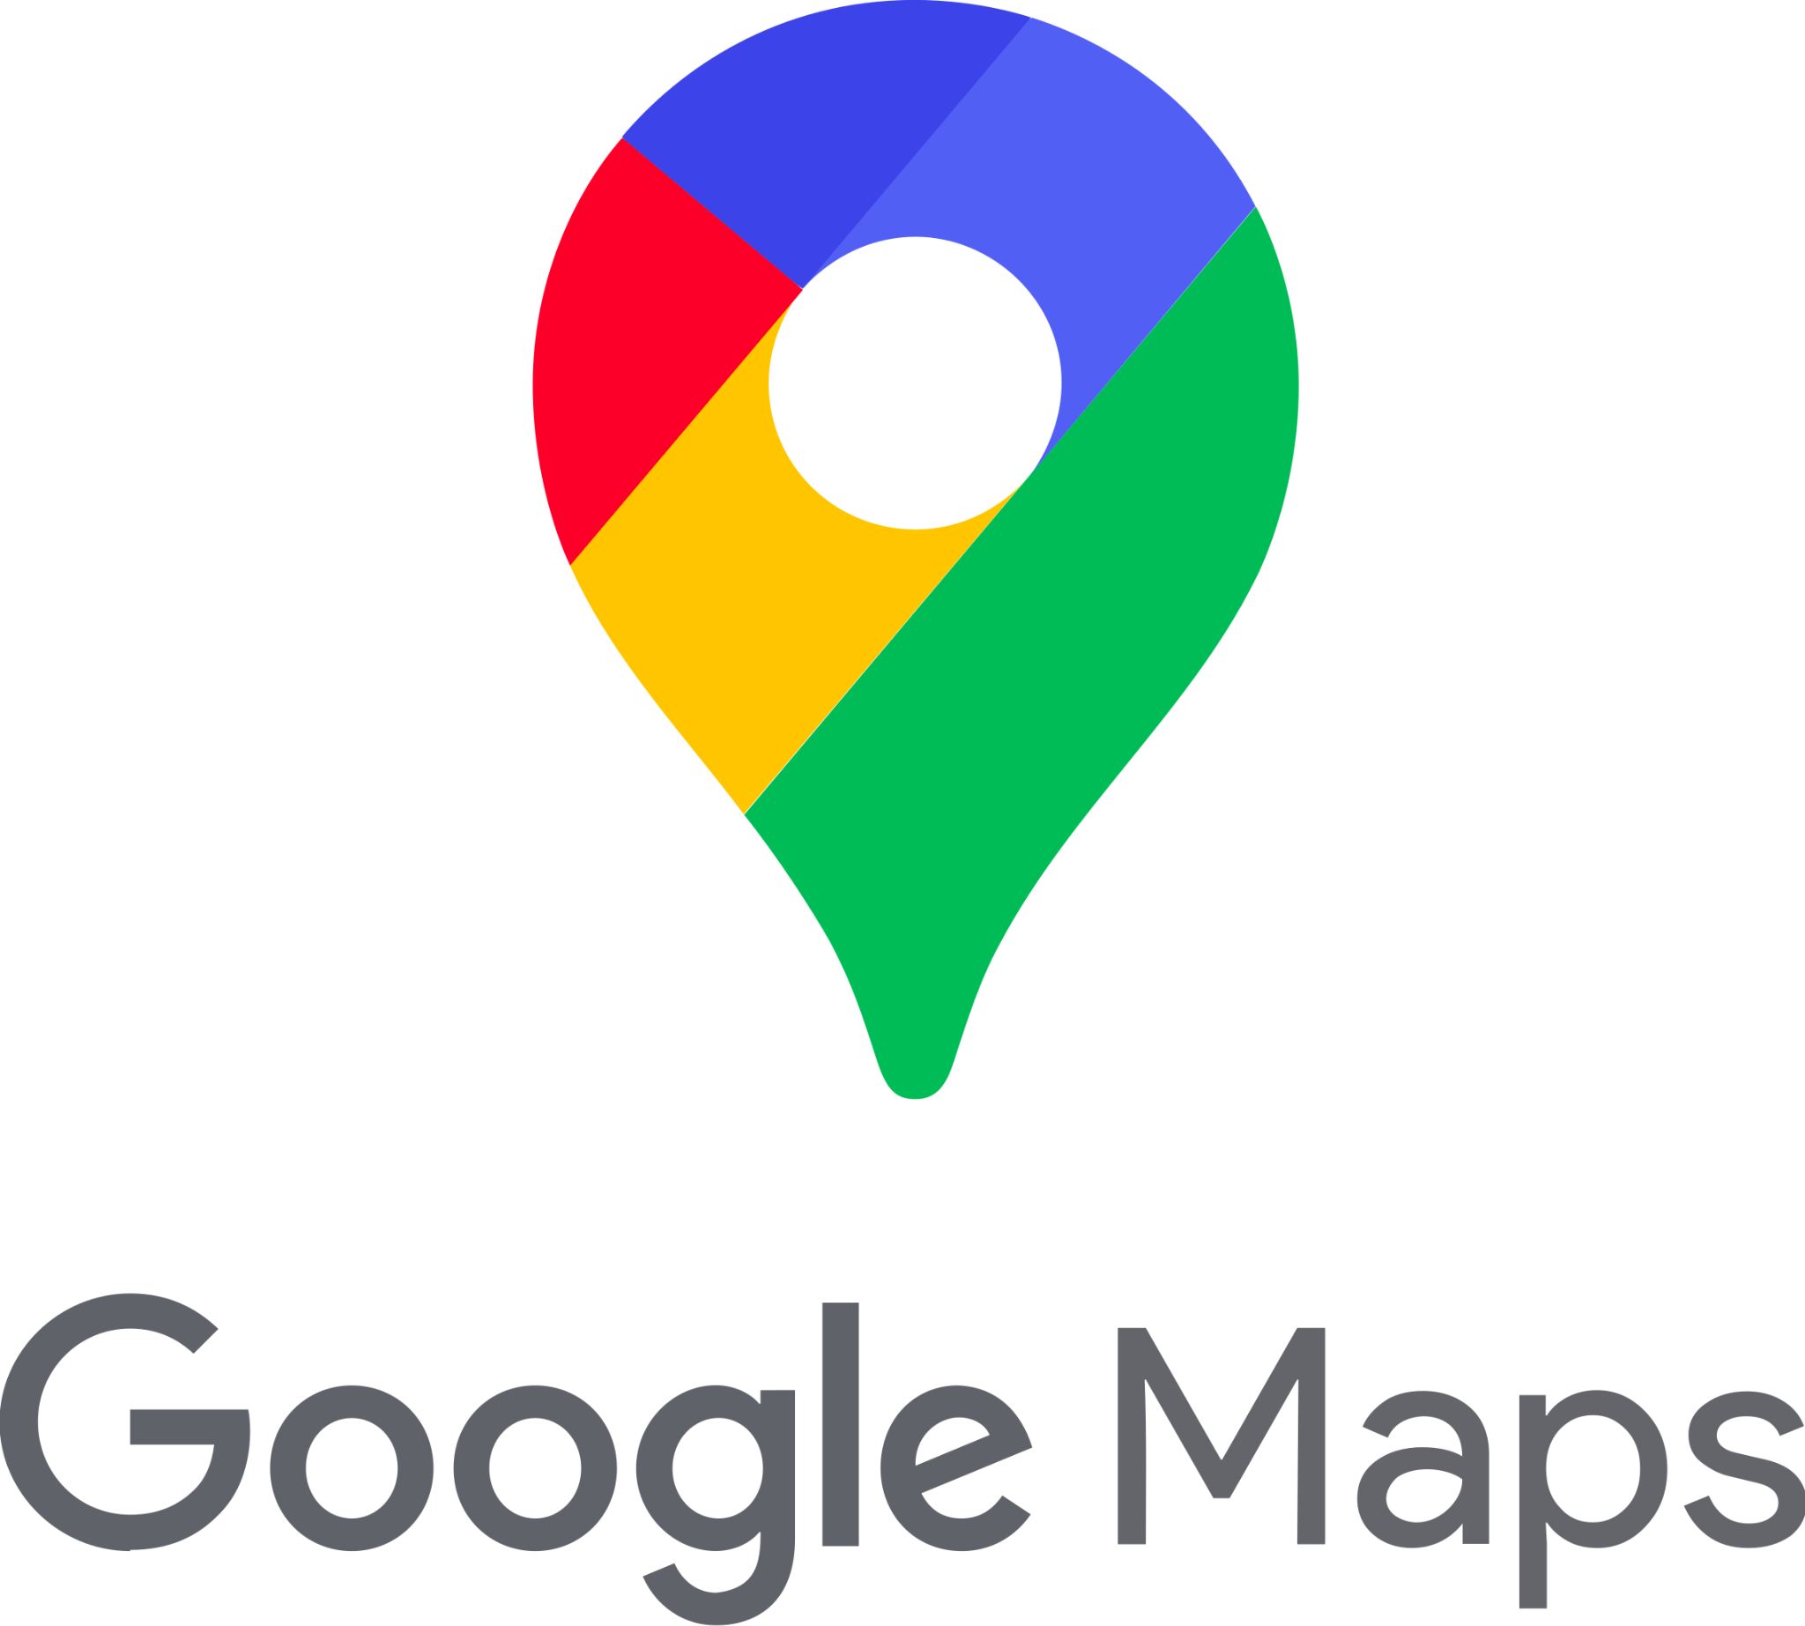


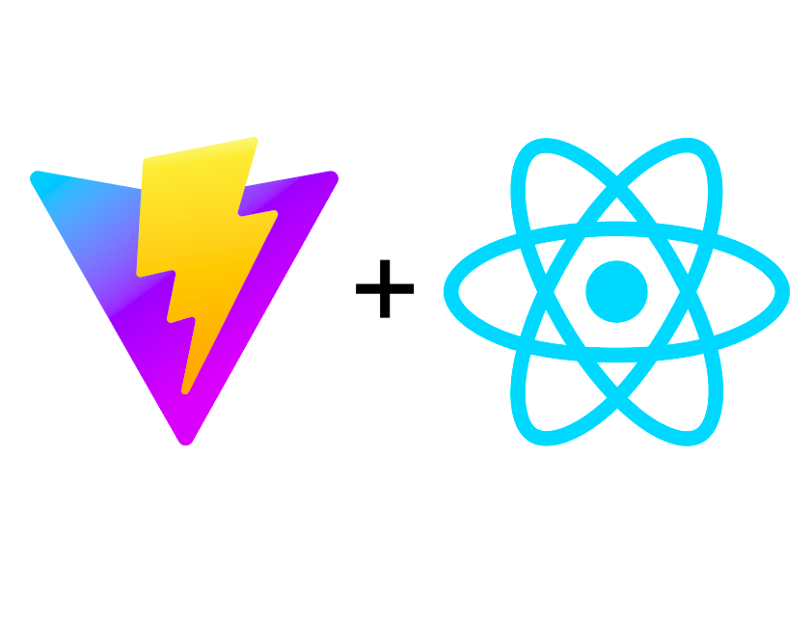



Slide 10
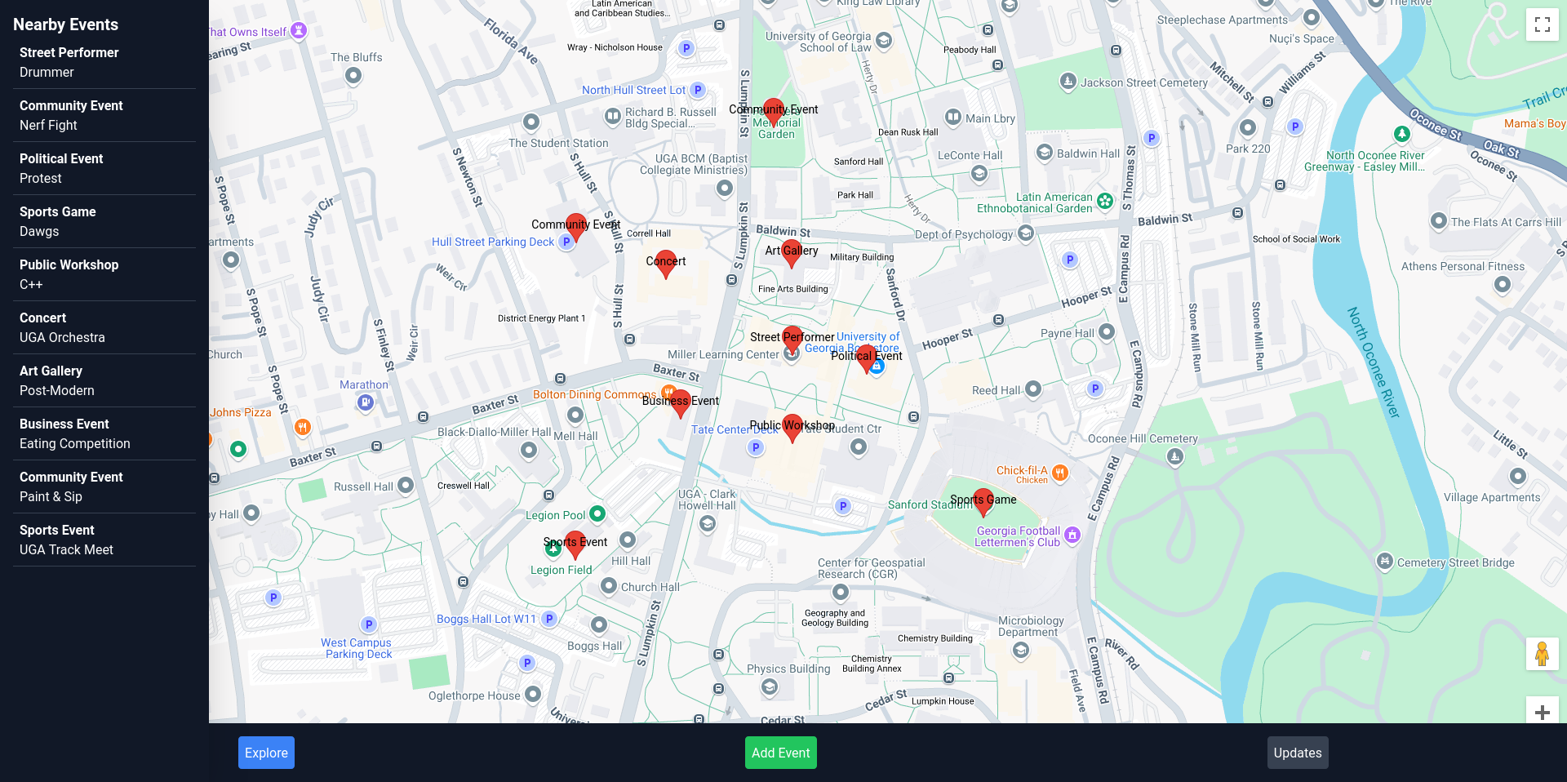

Slide 11

Future Plans
Host Entirely on Railway
Utilize Google Maps API advanced markers
AI detection of event type and details
User accounts
User Voting

Slide 12
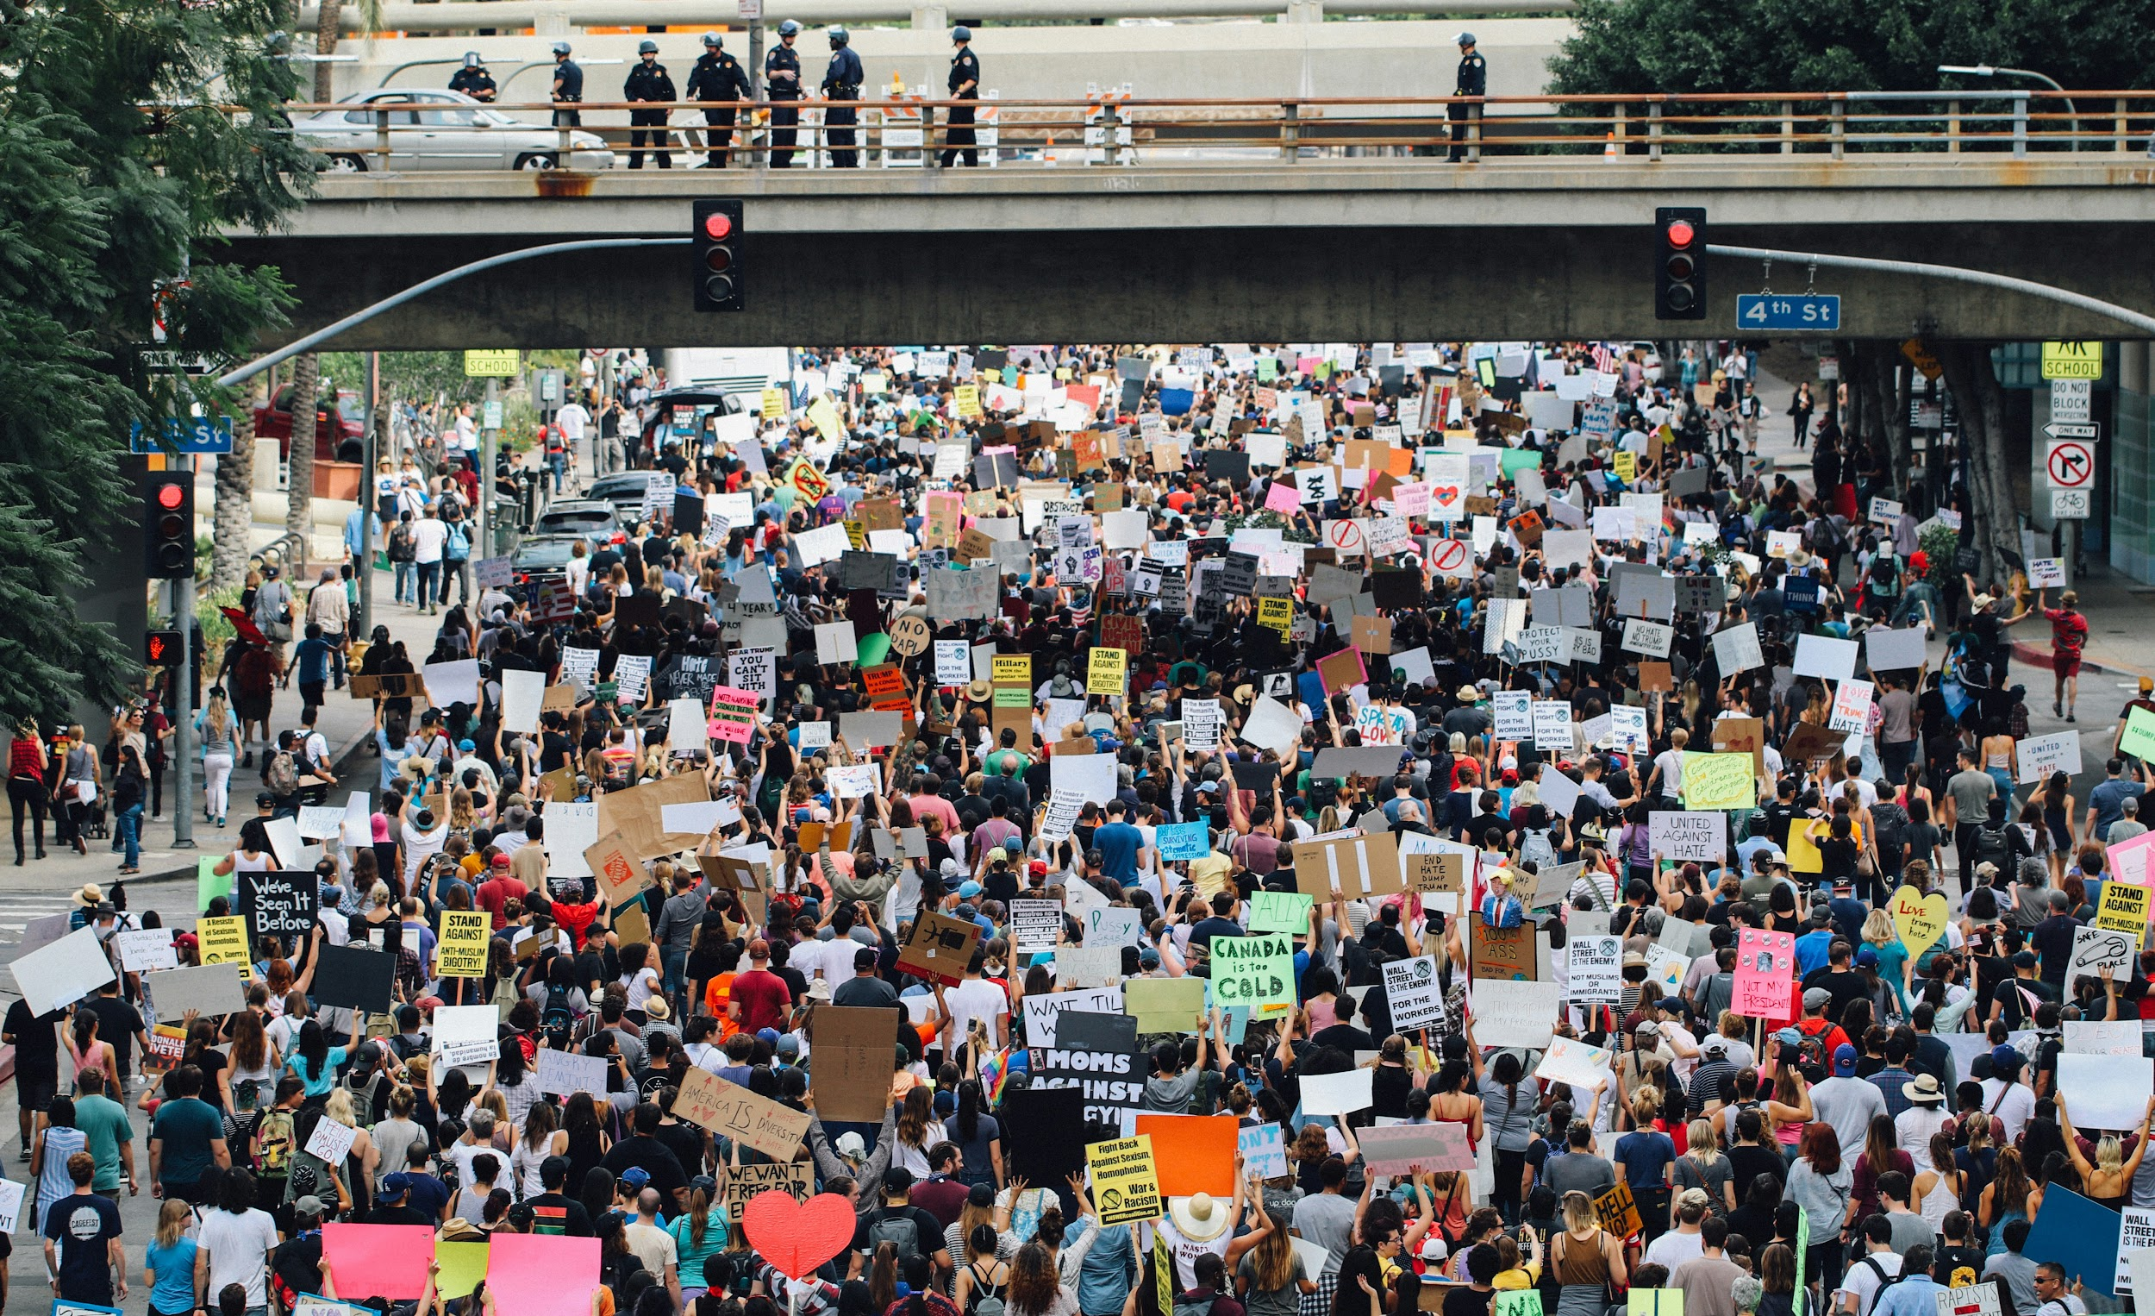

Why now?
We need each other, more than we could ever know. The toughest times, require the toughest communities.

Slide 13
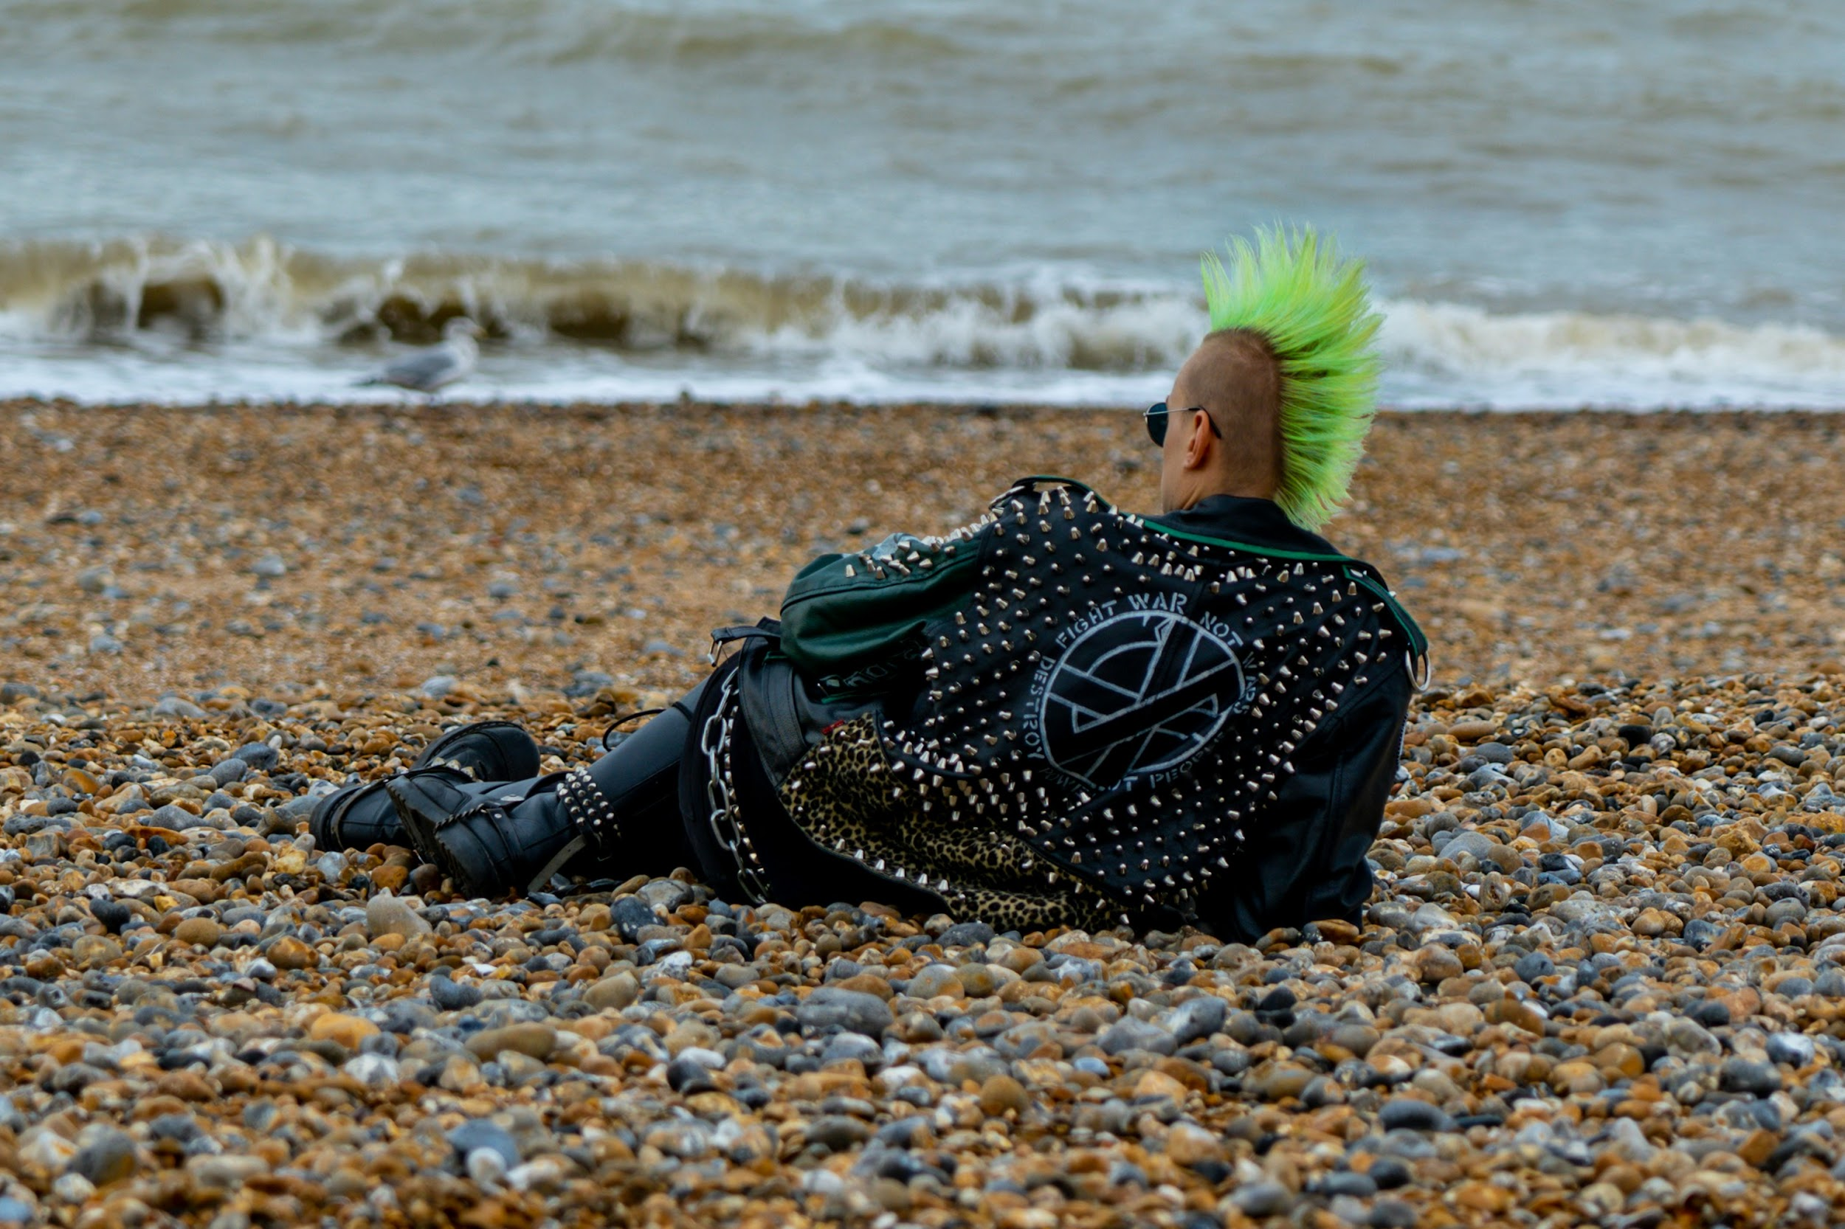
References
Images:
https://unsplash.com/
https://www.flaticon.com
Text:
https://www.statista.com/statistics/266249/advertising-revenue-of-google/
Thank You, Get Involved!

